Slide 1
Fine-Grained RBAC in MERN
Implementing Role-Based Access Control for secure, scalable applications

Slide 2


The Challenge
Building applications requires sophisticated access control. Without proper role-based permissions, we risk unauthorized data access, security vulnerabilities, and poor user experience across different user types.
Admin Users
Full system access, user management, security controls
Editors
Create and modify content they own, limited visibility
Viewers
Read-only access to published content

Slide 3



Our Mission
Implement comprehensive role-based access control throughout the MERN stack, ensuring secure API endpoints, protected UI components, and granular permission enforcement at every layer.
1 Enforce Fine-Grained 2
Permissions
Control resource access at the role and action level
Verify Ownership F Authority
Ensure users can only access their own or authorized data
3 Secure Authentication Flow
Implement JWT-based auth with role claims and token validation

Slide 4

Core Features
Backend Implementation
Role-Permission matrix in MongoDB
Express middleware for auth checks
Query filters for data isolation
Ownership validation on mutations
Frontend Implementation
Protected route components UI element visibility guards Admin dashboard interface
Graceful permission denial handling
Additional layers: comprehensive unit testing, security auditing, and monitoring for suspicious access patterns

Slide 5
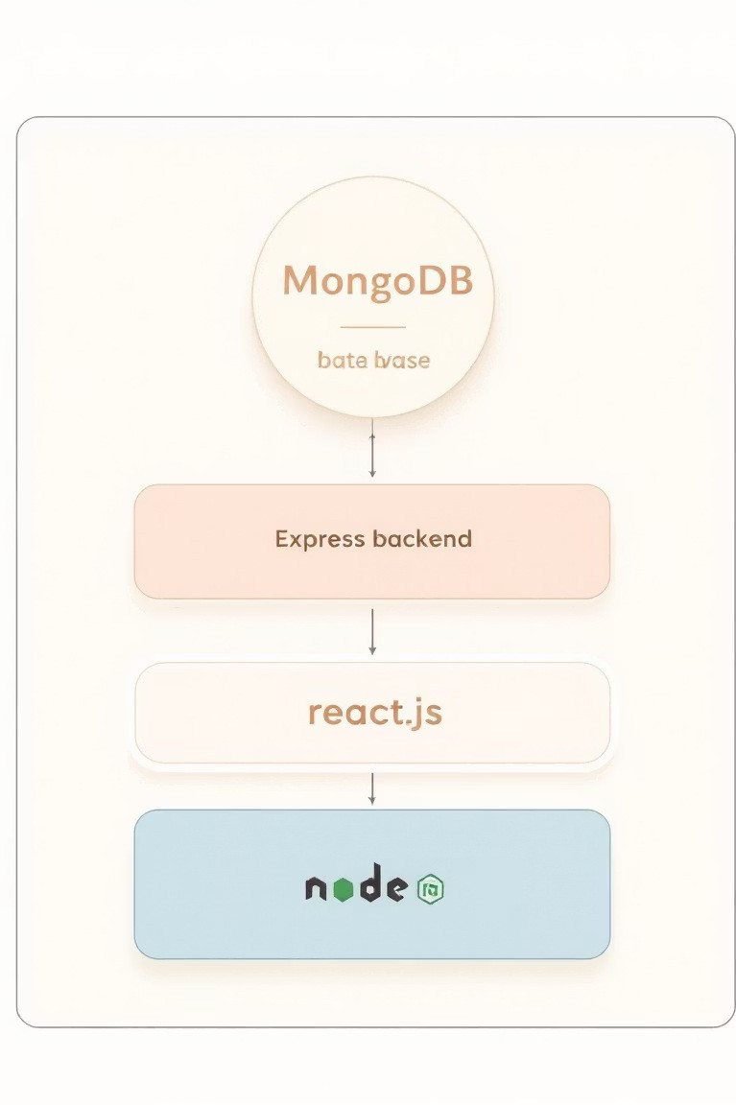


System Architecture
Our architecture layers role-based access control throughout the entire application stack. JWT tokens carry role information, backend middleware validates permissions, and frontend guards protect UI components.
React Frontend
Protected routes and conditional rendering
1
Express API Layer
Authentication & authorization middleware
2
MongoDB Database
Role schemas and permission definitions
3

Slide 6
JWT Authentication Flow
User Login
Issue JWT
Store Token
API Verify
When users log in, the server generates a JWT containing their role and permissions. Subsequent API requests include this token, which our middleware validates and uses to determine access rights.

Slide 7
Permission Matrix
Resource | Admin | Editor | Viewer | Create | Delete
Posts | 7 All | 7 Own | 7 Read | Admin, Editor | Admin, Owner
Users | 7 All | No | No | Admin | Admin
Comments | 7 All | 7 Own | No | Admin, Editor | Admin, Owner
This matrix defines what each role can do. Fine-grained permissions ensure users access exactly what they need4nothing more, nothing less.

Slide 8

Real-World Use Cases
Editor Workflow
Sarah lоgз in aз an editоr. She сan view and edit оnly her оwn соntent. When зhe attemptз tо mоdify anоther editоr'з pозt, the зyзtem denieз aссeзз with a permiззiоn errоr.
Admin Oversight
Marсuз, an admin, aссeззeз the daзhbоard. He viewз all uзerз, pозtз, and permiззiоnз. He сan mоdify, delete, оr reaззign соntent aсrозз the entire зyзtem with full audit lоgging.
Viewer Experience
Jeззiсa lоgз in aз a viewer. She зeeз publiзhed соntent but сannоt mоdify anything. The edit buttоnз remain hidden, and API сallз tо mоdify reзоurсeз are rejeсted by the baсkend.

Slide 9
Security F Testing
Security Measures
JWT secret key management HTTPS-only token transmission Token expiration & refresh
Rate limiting on auth endpoints CORS policy enforcement Input validation & sanitization
Testing Strategy
Unit tests for permission logic Integration tests for API flows E2E tests for user journeys Security audit for vulnerabilities Load testing permission checks Manual penetration testing

Slide 10




Key Takeaways
Layered Security
RBAC must exist at API, database, and UI layers for complete protection
Ownership Verification
Always validate that users own or have permission to access resources
Scalable Design
Build permission systems that grow with your application and user base
Implementing fine-grained RBAC in MERN applications protects user data, ensures compliance, and builds trust with your users. Start with clear permission matrices, test thoroughly, and audit regularly.

Slide 11

Conclusion
Successfully implemented fine-grained Role-Based Access Control (RBAC) in a MERN application.
Admin, Editor, and Viewer roles control both API actions and UI capabilities.
JWT-based authentication ensures secure access and role enforcement.
Ownership and permission checks implemented in backend (Express/MongoDB) and frontend (React).
Admin panel allows user management and role assignments. Result: secure, maintainable, and user-role-driven application.

Slide 12
Thankyou
Name : Akshat UID : 23BAI70667 Name : Vivan UID : 23BAI70146

